Slide 1
COE2266 PROGRAMMING LANGUAGES AND SYNTAX-DIRECTED TOOLS

Slide 2
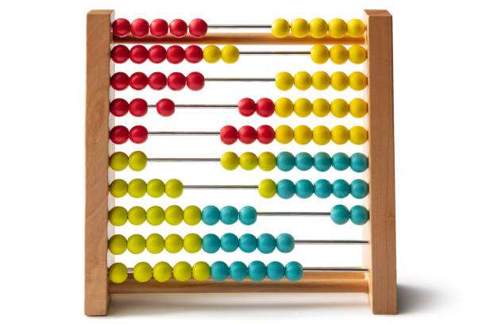
Programming Ideas
1200: The Abacus

Slide 3
1200: The Abacus
A set of rules the operator would use for making calculations.
The beads would hold the values of the calculations the operator had performed in his or her mind.

Slide 4
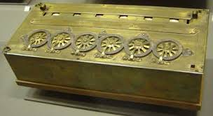
1642: The Pascaline Automatic Calculator

Slide 5
1642: The Pascaline
very advanced for its time
too complicated to operate.
used a series of dials

Slide 6
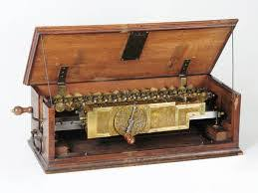
1673 - 1694: The Leibniz Calculator

Slide 7
1673 - 1694: The Leibniz Calculator
rapid multiplications or divisions
used wheels placed at right angles

Slide 8
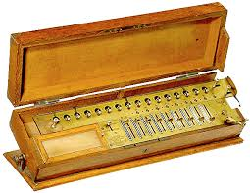
1820: The Arithmometer of Charles Xavior Thomas of Colmar

Slide 9
1820: The Arithmometer of Charles Xavior Thomas of Colmar
first truly successful desktop calculator
Based on Pascal and Leibniz

Slide 10
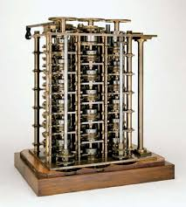
1823: The Difference Engine of Charles Babbage

Slide 11
1823: The Difference Engine of Charles Babbage
calculation of mathematical, celestial, and navigational tables
Powered by steam

Slide 12
Algorithm
Algorithm: 780 – 850 Abu Ja’far Muhammad ibn Musa
al-Khorezmi
calculus and binary system: 1646 – 1716 Gottfried Wilhelm Leibniz
First Computer Programmer: subroutine looping and the conditional jump: 1842: Ada Augusta King.
Logic programming: Gottlöb Frege (1848-1925)
1937: The Universal Machine of Alan Turing: capable of executing any describable algorithm
Functional programming: Alonzo Church (1903-1995)
Recursive functions & automata: Stephen Kleene (1909-1994)

Slide 13
programming language
1942: The ENIAC: first successful high-speed electronic digital computer (EDC).
1945: The Von Neuman Concepts: shared-program technique
1945: The "Bug" is Born: bug and debugging
1946: Plankalkul by Konrad Zuse: used binary arithmetic
1949: Short Code by John Mauchly: first computer language actually used on an electronic computing device.
1951 - 1957: FLOW-MATIC & The First Compiler
1951 Grace Hopper develops the first computer compiler which is called A-0 A-0 alsoo called Math-Matic

Slide 14
programming language
1952: Autocode by Alick E. Glennie
The programming system called AUTOCODE, was a rudimentary compiler.
1957: The Development of (FORmula TRANslating ) FORTRAN I by IBM for scientific computing.
1958: LISP (LISt Processing) by John McCarthy of MIT
1958: ALGOL 58
1959: COBOL (common business-oriented language) by Conference on Data Systems and Languages (CODASYL).
1960: APL (A Programming Language) by Kenneth Iverson

Slide 15
programming language
1962: SNOBOL ((StriNg-Oriented symBOlic Language) at Bell Laboratories
1963: PL/I (Programming Language 1) by IBM
1964: BASIC (Beginners All-purpose Symbolic Instruction Code) by two graduate students at Dartmouth, John Kennedy and Thomas Kurtz
1966: Logo: a functional language designed to teach programming and problem-solving principles to children.
1967: BCPL (Basic Combined Programming Language) by Marin Richards: an early block-structure procedural language, fairly low-level, and used for system and small application programming.
1970: Forth by Charles Moore: an interpreted stack-based language with a very simple syntax and elegant abstract exection model.

Slide 16
programming language
1970: Smalltalkby Alan Kay: a dynamic object-oriented language
1970: Icon: A decendent of SNOBOL, Icon is a procedural language with high-level semantics for string and data aggregate processing.
1971: Pascal by Niklaus Wirth: a simple block-structured language originally designed for computer science education.
1971: B by Dennis M. Ritchie and K. L. Thompson: based in BCPL, B is suited for non-numeric computations, typified by system programming
1971: sh by Steve Bourne: aka Bourne Shell, is no different from other shell scripting languages.
1972: Prolog (PROgramming in LOGic) by Alain Colmerauer and Phillip Roussel: using the logic paradigm is a very powerful one for certain problem domains, but unsuitable for some others.

Slide 17
programming language
1972: C by Dennis M. Richie: a fairly low-level block structured language with good support for system programming.
1975: Tiny BASIC by Bob Albrecht and Dennis Allison and implementation by Dick Whipple and John Arnold.
1975: Scheme: at MIT, Scheme, a dialect of LISP, was created with functional and procedural language aspects.
1975: The Microsoft Empire Takes Shape
1975: RATFOR (RATional FORTRAN)
1977: MUMPS aka M: The ANSI standard for MUMPS (Massachusetts General Hospital Utility Multi-Programming System) is released.
1978: Awk: an interpreted string-processing language developed at Bell Labs.

Slide 18
programming language
1979: Rexx: Originally invented as a sophisticated command language for IBM mainframe environments (MVS, CMS), Rexx has gained some popularity as a programming language with expressive power and convenience.
1980: Modula 2 conceived by Niklaus Wirth: construction and maintenance of real application software systems, unlike its predecessor Pascal.
1982: The Foundation of Adobe and PostScript
1983: Ada: Named in honor of Lady Ada Lovelace, Ada is a block-structured language with many object-oriented programming features
1983: C++: The name is coined by Rick Mascitti. C++ is a fairly complicated object-oriented language derived from C.

Slide 19
programming language
1983: C Compilers: Microsoft and Digital Research both release the first C compilers for microcomputers.
1986: Actor: Charles Duff releases Actor, an object-oriented language for developing Microsoft Windows applications
1986: Eiffel: An object-oriented language intended for general application programming
1987: Perl (Practical Extraction and Reporting Language): Perl interpreter was originally created for system administration and data reduction.
1988: Oberon by Niklaus Wirth: designed to be compact, efficient, and highly productive.

Slide 20
programming language
1990: J: conducted as an interactive session.
1991 - 2001: The Arrival of the Internet Languages
1991: Java: at Sun Microsystems, Java is a simple, portable object-oriented language.
1991: Python by Guido Rossum: Originally conceived to be an extensible scripting language for the Ameoba operating system, Python would be made into a portable language of its own very early in its development.
1991: Visual Basic: an advanced structured dialect of Basic that is intended for application development.
1992: Dylan: by Apple Dylan (DYnamic LANguage) is a dynamic object-oriented language with both procedural and functional features, intended for application development and system programming. 1993: Ruby

Slide 21
programming language
1994: JavaScript: by Netscape Communications for adding dynamic behavior to web pages, JavaScript was originally called 'LiveScript'.
1995: VBScript
Although VBScript was first developed in 1995, the first release of VBScript (v2.0) was part of Microsoft's Internet Explorer 3.0 which came out in 1997.

